Slide 1
Azure security
ISAH

Slide 2
Today’s subjects
Azure Active Directory
Microsoft Identity platform
Microsoft GRAPH
Well-Architected Framework

Slide 3
What is azure active directory
Azure Active Directory (Azure AD) is a cloud-based identity and access management service. This service helps your employees access external resources, such as Microsoft 365, the Azure portal, and thousands of other SaaS applications. Azure Active Directory also helps them access internal resources like apps on your corporate intranet network, along with any cloud apps developed for your own organization.

Slide 4
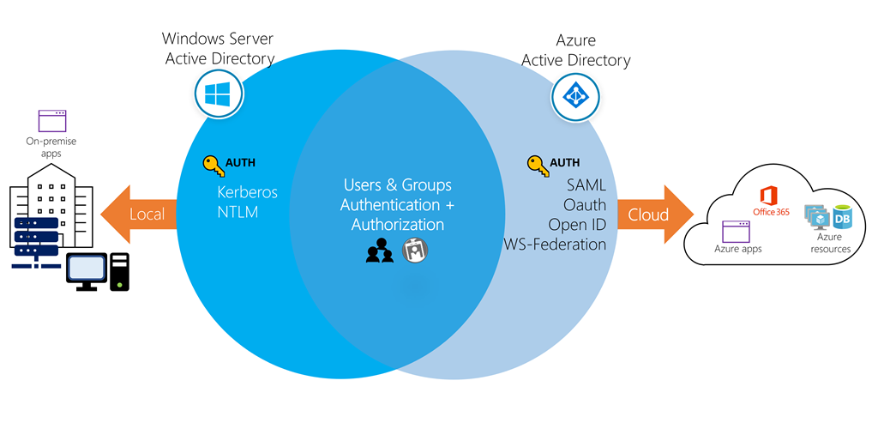
A cloud-based suite of identity management capabilities that enables you to securely manage access to Azure services and resources for your users
Provides application management, authentication, device management, and hybrid identity

Slide 5
Azure ad concepts
Concept
Description
Concept | Description
Identity | An object that can be authenticated.
Account | An identity that has data associated with it.
Azure AD Account | An identity created through Azure AD or another Microsoft cloud service.
Azure tenant | A dedicated and trusted instance of Azure AD that's automatically created when your organization signs up for a Microsoft cloud service subscription.
Azure AD directory | Each Azure tenant has a dedicated and trusted Azure AD directory.
User subscription | Used to pay for Azure cloud services.

Slide 6
AD DS vs Azure Active Directory
Azure AD is primarily an identity solution, and designed for HTTP and HTTPS communications
Queried using the REST API over HTTP and HTTPS. Instead of LDAP.
Uses HTTP and HTTPS protocols such as SAML, WS-Federation, and OpenID Connect for authentication (and OAuth for authorization). Instead of Kerberos
Includes federation services, and many third-party services (such as Facebook)
Azure AD users and groups are created in a flat structure, and there are no Organizational Units (OUs) or Group Policy Objects (GPOs)

Slide 7
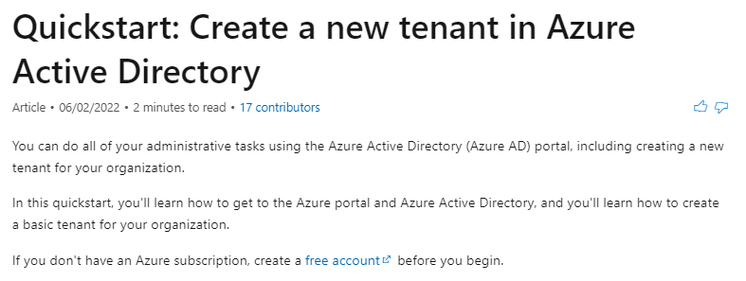
Making a new tenant
https://docs.microsoft.com/en-gb/azure/active-directory/fundamentals/active-directory-access-create-new-tenant

Slide 8
Who uses Azure ad
IT admins: As an IT admin, use Azure AD to control access to your apps and your app resources, based on your business requirements. For example, you can use Azure AD to require multi-factor authentication when accessing important organizational resources. You can also use Azure AD to automate user provisioning between your existing Windows Server AD and your cloud apps, including Microsoft 365. Finally, Azure AD gives you powerful tools to automatically help protect user identities and credentials and to meet your access governance requirements. To get started, sign up for a free 30-day Azure Active Directory Premium trial.
App developers: As an app developer, you can use Azure AD as a standards-based approach for adding single sign-on (SSO) to your app, allowing it to work with a user's pre-existing credentials. Azure AD also provides APIs that can help you build personalized app experiences using existing organizational data. To get started, sign up for a free 30-day Azure Active Directory Premium trial. For more information, you can also see Azure Active Directory for developers.
Microsoft 365, Office 365, Azure, or Dynamics CRM Online subscribers: As a subscriber, you're already using Azure AD. Each Microsoft 365, Office 365, Azure, and Dynamics CRM Online tenant is automatically an Azure AD tenant. You can immediately start to manage access to your integrated cloud apps.

Slide 9
Azure ad licenses
Azure Active Directory Free. Provides user and group management, on-premises directory synchronization, basic reports, self-service password change for cloud users, and single sign-on across Azure, Microsoft 365, and many popular SaaS apps.
Azure Active Directory Premium P1. In addition to the Free features, P1 also lets your hybrid users access both on-premises and cloud resources. It also supports advanced administration, such as dynamic groups, self-service group management, Microsoft Identity Manager, and cloud write-back capabilities, which allow self-service password reset for your on-premises users.
Azure Active Directory Premium P2. In addition to the Free and P1 features, P2 also offers Azure Active Directory Identity Protection to help provide risk-based Conditional Access to your apps and critical company data and Privileged Identity Management to help discover, restrict, and monitor administrators and their access to resources and to provide just-in-time access when needed.

Slide 10
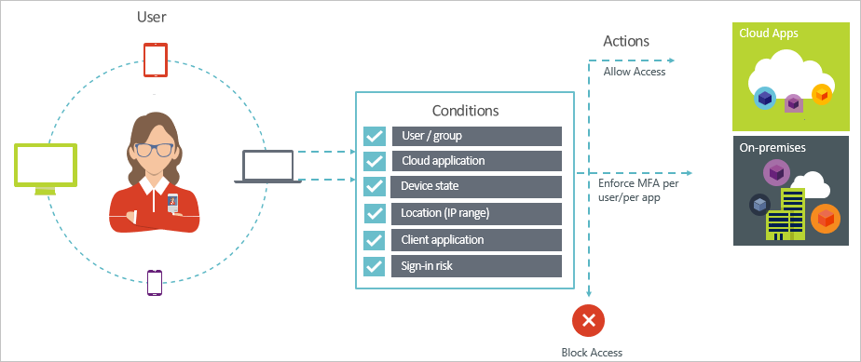
Multi-Factor Authentication
Provides two step authentication verification
Lets you enforce controls on access to apps based on specific conditions
Conditions – “When this happens”
Access controls – “Then do this”

Slide 11
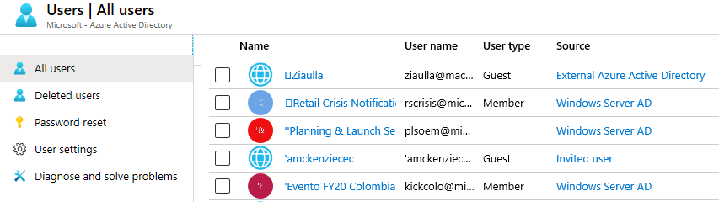
User Accounts
All users must have an account
The account is used for authentication and authorization
Identity Sources: Cloud, Directory-synchronized, and Guest

Slide 12
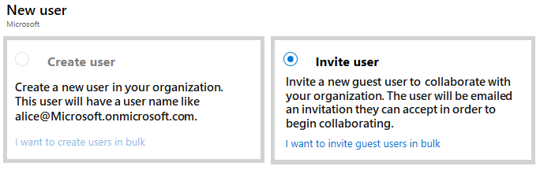
Managing User Accounts
Must be Global Administrator to manage users
User profile (picture, job, contact info) is optional
Deleted users can be restored for 30 days
Sign in and audit log information is available

Slide 13
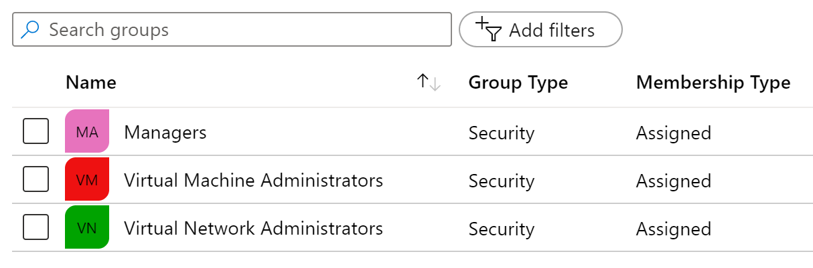
Group Accounts
Group Types
Security groups
Office 365 groups
Assignment Types
Assigned
Dynamic User
Dynamic Device (Security groups only)

Slide 14
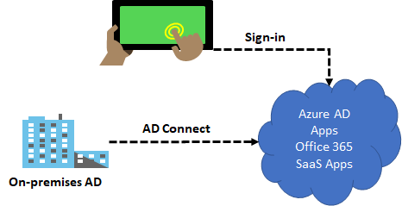
Azure AD Connect
Integrate your on-premises directories with Azure Active Directory
Provides a common identity for your users for Office 365, Azure, and SaaS applications integrated with Azure AD
There are several authentication options – password hash synchronization and pass-through authentication

Slide 15
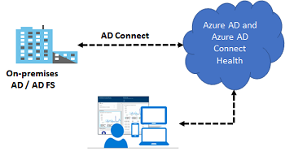
Azure AD Connect Health
Monitor and gain insights into AD FS servers, Azure AD Connect, and AD domain controllers
Monitor and gain insights into the synchronizations that occur between your on-premises AD DS and Azure AD
Monitor and gain insights into your on-premises identity infrastructure that is used to access Office 365 or other Azure AD applications

Slide 16
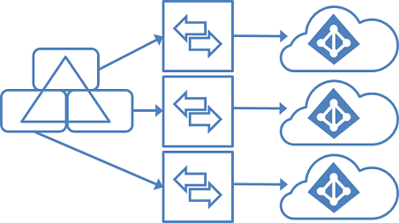
Managing Multiple Directories
In Azure Active Directory (Azure AD), each tenant is a fully independent resource
There is no parent-child relationship between tenants
This independence between tenants includes resource, administrative, and synchronization
✔️ It is recommended to use a supported synchronization configuration

Slide 17



Azure AD B2B and B2C
Business to Business (B2B)
Inviting users from other Azure AD Tenants into your own organization tenant
User provisioning is done by the invited party
Business to Consumer (B2C)
Inviting users from other social media Identity Tenants into your own organization tenant
User provisioning is done by the invited party; you are in control to invite the other side’s users

Slide 18
Demonstration – Users and Groups
Determine domain information
Explore user accounts
Explore group accounts
Explore PowerShell for group management

Slide 19
Lab 01 - Manage Azure Active Directory Identities
Lab scenario
In order to allow Contoso users to authenticate by using Azure AD, you have been tasked with provisioning users and group accounts. Membership of the groups should be updated automatically based on the user job titles. You also need to create a test Azure AD tenant with a test user account and grant that account limited permissions to resources in the Contoso Azure subscription.
Objectives
Task 1: Create and configure Azure AD users
Task 2: Create Azure AD groups with assigned and dynamic membership
Task 3: Create an Azure Active Directory (AD) tenant
Task 4: Manage Azure AD guest users

Slide 20
Lab 01 - Manage Azure Active Directory Identities
https://github.com/MicrosoftLearning/AZ-104-MicrosoftAzureAdministrator/blob/master/Instructions/Labs/LAB_01-Manage_Azure_AD_Identities.md

Slide 21
Microsoft identity platform
The Microsoft identity platform helps you build applications your users and customers can sign in to using their Microsoft identities or social accounts, and provide authorized access to your own APIs or Microsoft APIs like Microsoft Graph.
For developers, the Microsoft identity platform offers integration of modern innovations in the identity and security space like passwordless authentication, step-up authentication, and Conditional Access. You don’t need to implement such functionality yourself: applications integrated with the Microsoft identity platform natively take advantage of such innovations.

Slide 22
components
OAuth 2.0 and OpenID Connect standard-compliant authentication service enabling developers to authenticate several identity types, including:
Work or school accounts, provisioned through Azure AD
Personal Microsoft account, like Skype, Xbox, and Outlook.com
Social or local accounts, by using Azure AD B2C
Open-source libraries: Microsoft Authentication Libraries (MSAL) and support for other standards-compliant libraries
Application management portal: A registration and configuration experience in the Azure portal, along with the other Azure management capabilities.
Application configuration API and PowerShell: Programmatic configuration of your applications through the Microsoft Graph API and PowerShell so you can automate your DevOps tasks.
Developer content: Technical documentation including quickstarts, tutorials, how-to guides, and code samples.

Slide 23
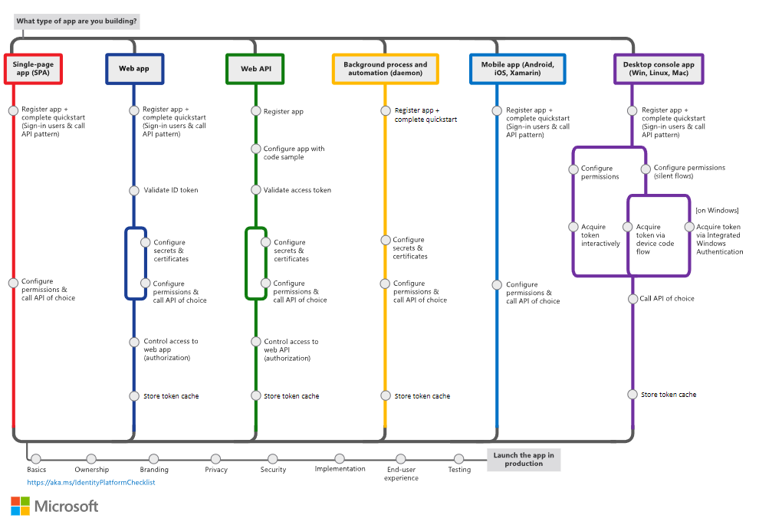

Slide 24
OAuth 2.0 and OpenID Connect (OIDC) in the Microsoft identity platform
You don't need to learn OAuth or OpenID Connect (OIDC) at the protocol level to use the Microsoft identity platform. You will, however, encounter these and other protocol terms and concepts as you use the identity platform to add auth functionality to your apps.
As you work with the Azure portal, the documentation, and the authentication libraries, knowing a few basics like these can make your integration and debugging tasks easier.

Slide 25
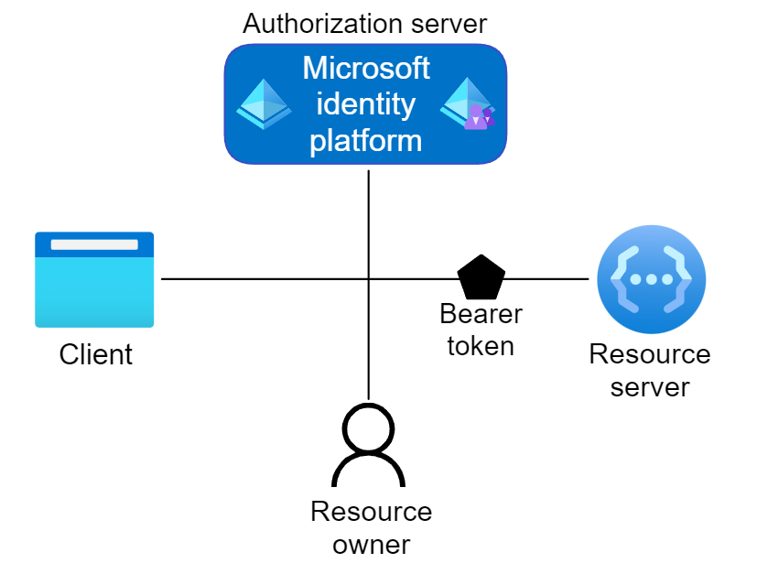
Roles in OAuth 2.0
Four parties are typically involved in an OAuth 2.0 and OpenID Connect authentication and authorization exchange. Such exchanges are often called authentication flows or auth flows.

Slide 26
Authorization server - The Microsoft identity platform itself is the authorization server. Also called an identity provider or IdP, it securely handles the end-user's information, their access, and the trust relationships between the parties in the auth flow. The authorization server issues the security tokens your apps and APIs use for granting, denying, or revoking access to resources (authorization) after the user has signed in (authenticated).
Client - The client in an OAuth exchange is the application requesting access to a protected resource. The client could be a web app running on a server, a single-page web app running in a user's web browser, or a web API that calls another web API. You'll often see the client referred to as client application, application, or app.
Resource owner - The resource owner in an auth flow is typically the application user, or end-user in OAuth terminology. The end-user "owns" the protected resource--their data--your app accesses on their behalf. The resource owner can grant or deny your app (the client) access to the resources they own. For example, your app might call an external system's API to get a user's email address from their profile on that system. Their profile data is a resource the end-user owns on the external system, and the end-user can consent to or deny your app's request to access their data.
Resource server - The resource server hosts or provides access to a resource owner's data. Most often, the resource server is a web API fronting a data store. The resource server relies on the authorization server to perform authentication and uses information in bearer tokens issued by the authorization server to grant or deny access to resources.

Slide 27
tokens
Access tokens - Access tokens are issued by the authorization server to the client application. The client passes access tokens to the resource server. Access tokens contain the permissions the client has been granted by the authorization server.
ID tokens - ID tokens are issued by the authorization server to the client application. Clients use ID tokens when signing in users and to get basic information about them.
Refresh tokens - The client uses a refresh token, or RT, to request new access and ID tokens from the authorization server. Your code should treat refresh tokens and their string content as opaque because they're intended for use only by authorization server.

Slide 28
App registration
Your client app needs a way to trust the security tokens issued to it by the Microsoft identity platform. The first step in establishing that trust is by registering your app with the identity platform in Azure Active Directory (Azure AD).
When you register your app in Azure AD, the Microsoft identity platform automatically assigns it some values, while others you configure based on the application's type.
Two the most commonly referenced app registration settings are:
Application (client) ID - Also called application ID and client ID, this value is assigned to your app by the Microsoft identity platform. The client ID uniquely identifies your app in the identity platform and is included in the security tokens the platform issues.
Redirect URI - The authorization server uses a redirect URI to direct the resource owner's user-agent (web browser, mobile app) to another destination after completing their interaction. For example, after the end-user authenticates with the authorization server. Not all client types use redirect URIs.
Your app's registration also holds information about the authentication and authorization endpoints you'll use in your code to get ID and access tokens.

Slide 29
endpoints
The Microsoft identity platform offers authentication and authorization services using standards-compliant implementations of OAuth 2.0 and OpenID Connect (OIDC) 1.0. Standards-compliant authorization servers like the Microsoft identity platform provide a set of HTTP endpoints for use by the parties in an auth flow to execute the flow.
The endpoint URIs for your app are generated for you when you register or configure your app in Azure AD. The endpoints you use in your app's code depend on the application's type and the identities (account types) it should support.

Slide 30
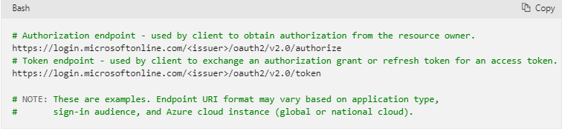
endpoints
Two commonly used endpoints are the authorization endpoint and token endpoint. Here are examples of the authorize and token endpoints:
To find the endpoints for an application you've registered, in the Azure portal navigate to:
Azure Active Directory > App registrations > <YOUR-APPLICATION> > Endpoints

Slide 31
Authentication flows and application scenarios
The Microsoft identity platform supports authentication for different kinds of modern application architectures. All of the architectures are based on the industry-standard protocols OAuth 2.0 and OpenID Connect. By using the authentication libraries for the Microsoft identity platform, applications authenticate identities and acquire tokens to access protected APIs.

Slide 32
scenarios
The Microsoft identity platform supports authentication for these app architectures:
Single-page apps
Web apps
Web APIs
Mobile apps
Native apps
Daemon apps
Server-side apps
Applications use the different authentication flows to sign in users and get tokens to call protected APIs.

Slide 33
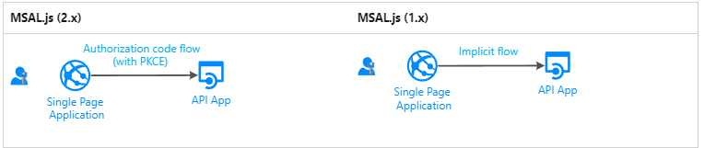
Single-page application
Many modern web apps are built as client-side single-page applications. These applications use JavaScript or a framework like Angular, Vue, and React. These applications run in a web browser.
Single-page applications differ from traditional server-side web apps in terms of authentication characteristics. By using the Microsoft identity platform, single-page applications can sign in users and get tokens to access back-end services or web APIs. The Microsoft identity platform offers two grant types for JavaScript applications:

Slide 34

Web app that signs in a user
To help protect a web app that signs in a user:
If you develop in .NET, you use ASP.NET or ASP.NET Core with the ASP.NET OpenID Connect middleware. Protecting a resource involves validating the security token, which is done by the IdentityModel extensions for .NET and not MSAL libraries.
If you develop in Node.js, you use MSAL Node.
Notes:
https://docs.microsoft.com/en-gb/azure/active-directory/develop/authentication-flows-app-scenarios
IdentityModel extensions for .NET https://github.com/AzureAD/azure-activedirectory-identitymodel-extensions-for-dotnet/wiki
https://github.com/AzureAD/microsoft-authentication-library-for-js/tree/dev/lib/msal-node
https://docs.microsoft.com/en-gb/azure/active-directory/develop/scenario-web-app-sign-user-overview?tabs=aspnetcore

Slide 35
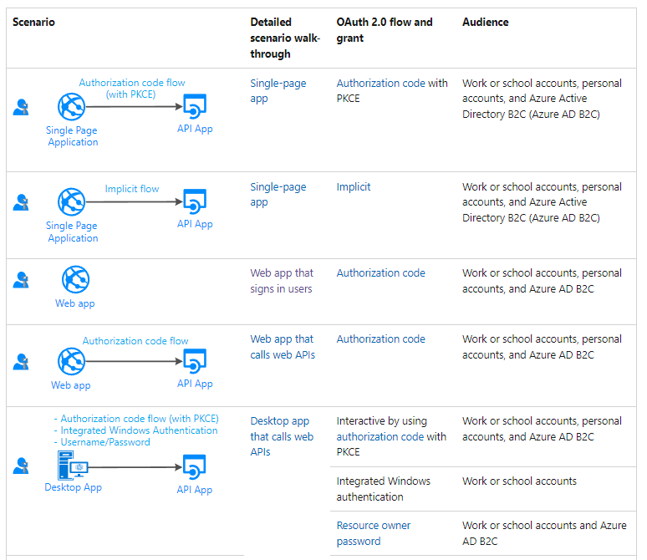

Slide 36
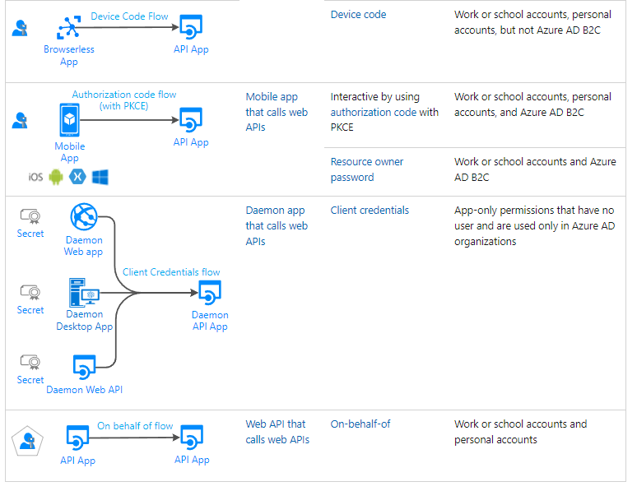

Slide 37
supported platforms and languages
Microsoft Authentication Libraries support multiple platforms:
.NET Core
.NET Framework
Java
JavaScript
macOS
Native Android
Native iOS
Node.js
Python
Windows 10/UWP
Xamarin.iOS
Xamarin.Android
You can also use various languages to build your applications.

Slide 38
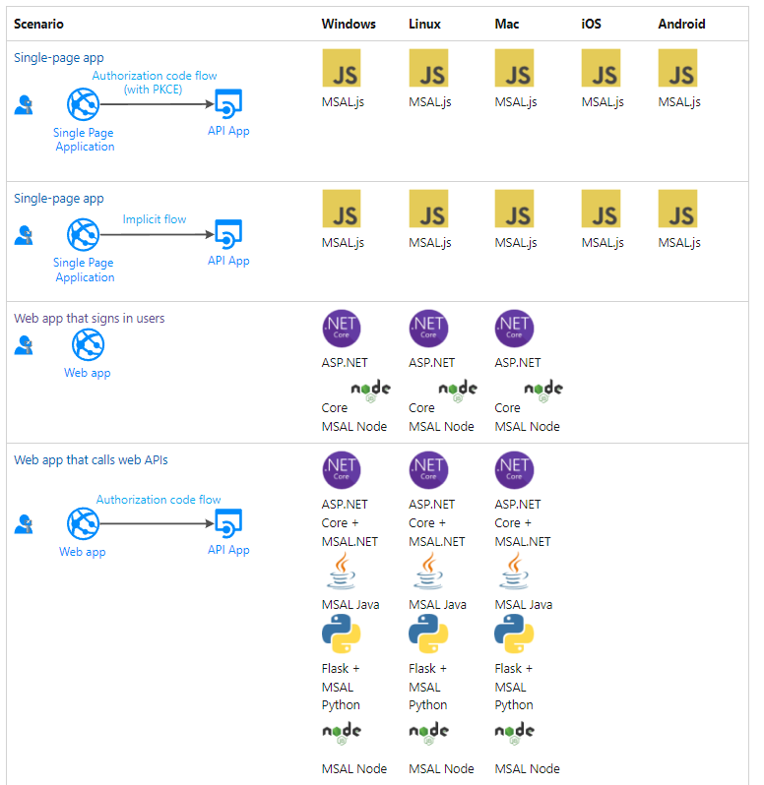

Slide 39
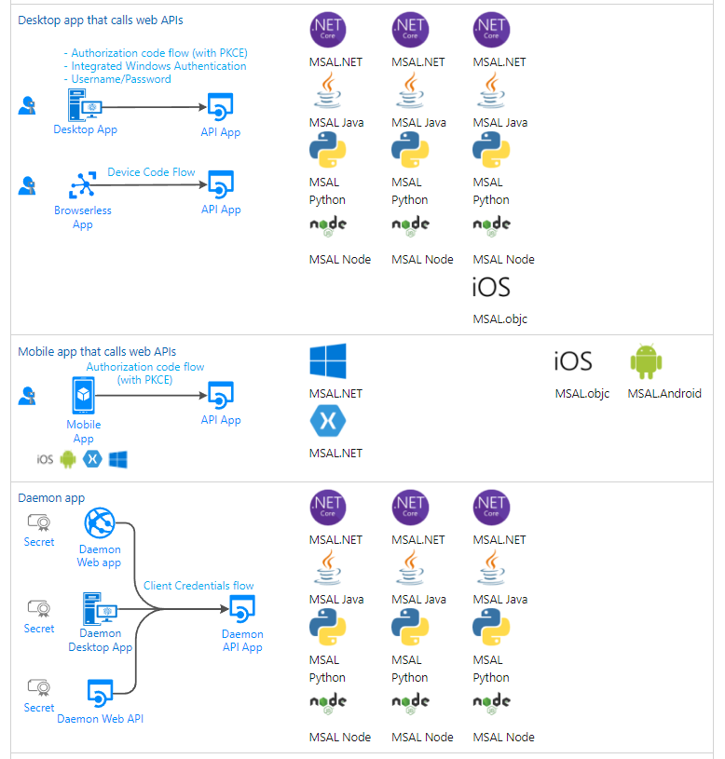

Slide 40
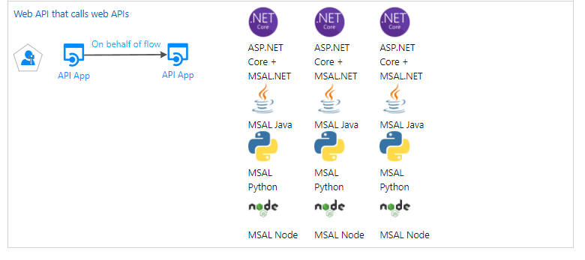

Slide 41
Tutorial: Sign in users and call the Microsoft Graph API from a JavaScript single-page app (SPA) using auth code flow
n this tutorial, you build a JavaScript single-page application (SPA) that signs in users and calls Microsoft Graph by using the authorization code flow with PKCE. The SPA you build uses the Microsoft Authentication Library (MSAL) for JavaScript v2.0.
In this tutorial:
Perform the OAuth 2.0 authorization code flow with PKCE
Sign in personal Microsoft accounts as well as work and school accounts
Acquire an access token
Call Microsoft Graph or your own API that requires access tokens obtained from the Microsoft identity platform
https://docs.microsoft.com/en-us/azure/active-directory/develop/quickstart-register-app
Notes:
https://docs.microsoft.com/en-us/azure/active-directory/develop/quickstart-register-app

Slide 42
Tutorial: Add sign-in to Microsoft to an ASP.NET web app
In this tutorial, you build an ASP.NET MVC web app that signs in users by using the Open Web Interface for .NET (OWIN) middleware and the Microsoft identity platform.
When you've completed this guide, your application will be able to accept sign-ins of personal accounts from the likes of outlook.com and live.com. Additionally, work and school accounts from any company or organization that's integrated with the Microsoft identity platform will be able to sign in to your app.
In this tutorial:
Create an ASP.NET Web Application project in Visual Studio
Add the Open Web Interface for .NET (OWIN) middleware components
Add code to support user sign-in and sign-out
Register the app in the Azure portal
Test the app
https://docs.microsoft.com/en-gb/azure/active-directory/develop/tutorial-v2-asp-webapp

Slide 43
Microsoft identity platform code samples
These code samples are built and maintained by Microsoft to demonstrate usage of our authentication libraries with the Microsoft identity platform. Common authentication and authorization scenarios are implemented in several application types, development languages, and frameworks.
Sign in users to web applications and provide authorized access to protected web APIs.
Protect a web API by requiring an access token to perform API operations.
Each code sample includes a README.md file describing how to build the project (if applicable) and run the sample application. Comments in the code help you understand how these libraries are used in the application to perform authentication and authorization by using the identity platform.
https://docs.microsoft.com/en-gb/azure/active-directory/develop/sample-v2-code

Slide 44
Service principals
To access resources that are secured by an Azure AD tenant, the entity that requires access must be represented by a security principal. This requirement is true for both users (user principal) and applications (service principal). The security principal defines the access policy and permissions for the user/application in the Azure AD tenant. This enables core features such as authentication of the user/application during sign-in, and authorization during resource access.
After registering an app you will have a global unique instance of the app (application object) in your home tenant or directory. A service principal object will automatically be created

Slide 45
Types of service principals
Application - The type of service principal is the local representation, or application instance, of a global application object in a single tenant or directory. In this case, a service principal is a concrete instance created from the application object and inherits certain properties from that application object. A service principal is created in each tenant where the application is used and references the globally unique app object. The service principal object defines what the app can actually do in the specific tenant, who can access the app, and what resources the app can access.
When an application is given permission to access resources in a tenant (upon registration or consent), a service principal object is created. When you register an application using the Azure portal, a service principal is created automatically. You can also create service principal objects in a tenant using Azure PowerShell, Azure CLI, Microsoft Graph, and other tools.

Slide 46
Types of service principals
Managed identity - This type of service principal is used to represent a managed identity. Managed identities eliminate the need for developers to manage credentials. Managed identities provide an identity for applications to use when connecting to resources that support Azure AD authentication. When a managed identity is enabled, a service principal representing that managed identity is created in your tenant. Service principals representing managed identities can be granted access and permissions, but cannot be updated or modified directly.

Slide 47
Types of service principals
Legacy - This type of service principal represents a legacy app, which is an app created before app registrations were introduced or an app created through legacy experiences. A legacy service principal can have credentials, service principal names, reply URLs, and other properties that an authorized user can edit, but does not have an associated app registration. The service principal can only be used in the tenant where it was created.

Slide 48
Managed identities for azure resources
A common challenge for developers is the management of secrets and credentials used to secure communication between different components making up a solution. Managed identities eliminate the need for developers to manage credentials.
Managed identities provide an identity for applications to use when connecting to resources that support Azure Active Directory (Azure AD) authentication. Applications may use the managed identity to obtain Azure AD tokens. With Azure Key Vault, developers can use managed identities to access resources. Key Vault stores credentials in a secure manner and gives access to storage accounts.

Slide 49
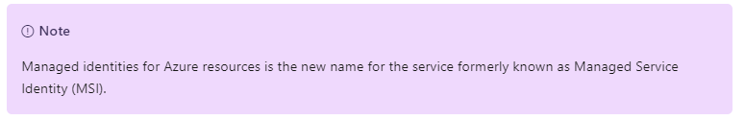
benefits
Here are some of the benefits of using managed identities:
You don't need to manage credentials. Credentials aren’t even accessible to you.
You can use managed identities to authenticate to any resource that supports Azure AD authentication, including your own applications.
Managed identities can be used without any additional cost.

Slide 50
Managed identity types
There are two types of managed identities:
System-assigned. Some Azure services allow you to enable a managed identity directly on a service instance. When you enable a system-assigned managed identity, an identity is created in Azure AD. The identity is tied to the lifecycle of that service instance. When the resource is deleted, Azure automatically deletes the identity for you. By design, only that Azure resource can use this identity to request tokens from Azure AD.
User-assigned. You may also create a managed identity as a standalone Azure resource. You can create a user-assigned managed identity and assign it to one or more instances of an Azure service. For user-assigned managed identities, the identity is managed separately from the resources that use it.

Slide 51
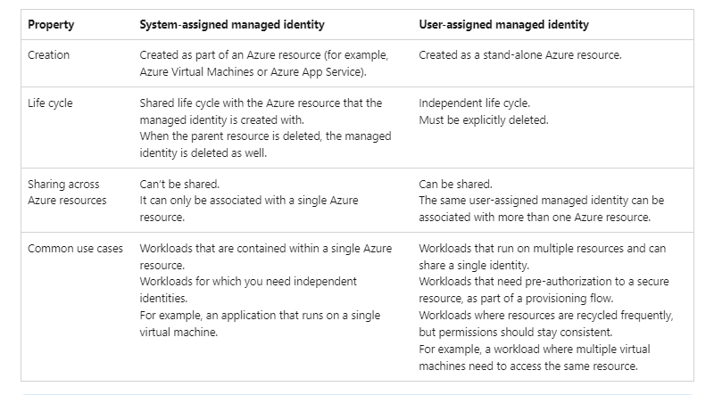
differences

Slide 52
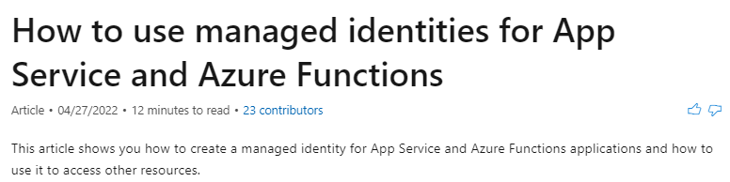
Tutorial: adding managed identity
https://docs.microsoft.com/en-us/azure/app-service/overview-managed-identity?context=%2Fazure%2Factive-directory%2Fmanaged-identities-azure-resources%2Fcontext%2Fmsi-context&tabs=portal%2Chttp

Slide 53
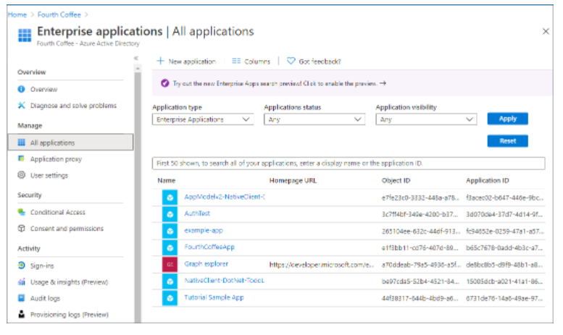
Enterprise application blade
You can use the Enterprise applications blade in the Azure portal to list and manage the service principals in a tenant. You can see the service principal's permissions, user consented permissions, which users have done that consent, sign in information, and more.

Slide 54
Relationship between application objects and service principals
The application object is the global representation of your application for use across all tenants, and the service principal is the local representation for use in a specific tenant. The application object serves as the template from which common and default properties are derived for use in creating corresponding service principal objects.
An application object has:
A 1:1 relationship with the software application, and
A 1:many relationship with its corresponding service principal object(s).
A service principal must be created in each tenant where the application is used, enabling it to establish an identity for sign-in and/or access to resources being secured by the tenant. A single-tenant application has only one service principal (in its home tenant), created and consented for use during application registration. A multi-tenant application also has a service principal created in each tenant where a user from that tenant has consented to its use.

Slide 55
Consequences of modifying and deleting applications
Any changes that you make to your application object are also reflected in its service principal object in the application's home tenant only (the tenant where it was registered). This means that deleting an application object will also delete its home tenant service principal object. However, restoring that application object will not restore its corresponding service principal. For multi-tenant applications, changes to the application object are not reflected in any consumer tenants' service principal objects until the access is removed through the Application Access Panel and granted again.
Notes:
https://docs.microsoft.com/en-us/azure/active-directory/develop/app-objects-and-service-principals
EXAMPLE

Slide 56
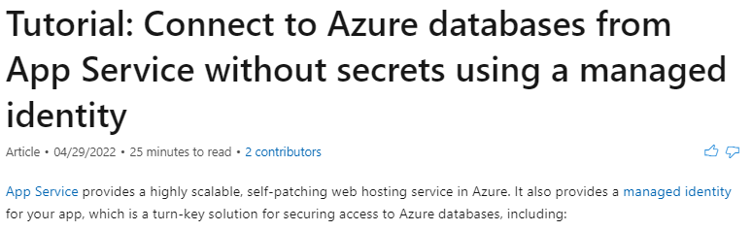
Tutorial: Connect to Azure databases from App Service
https://docs.microsoft.com/en-us/azure/app-service/tutorial-connect-msi-azure-database?tabs=sqldatabase%2Csystemassigned%2Cnetfx%2Cwindowsclient

Slide 57
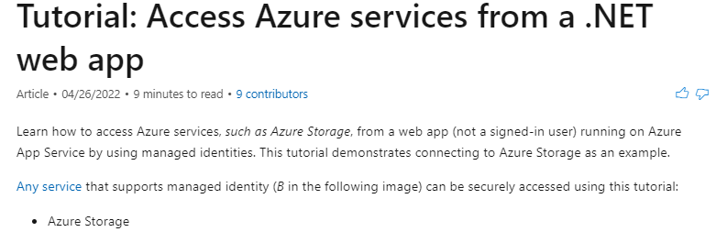
Tutorial: Access Azure services from a .NET web app
https://docs.microsoft.com/en-us/azure/app-service/scenario-secure-app-access-storage?tabs=azure-portal

Slide 58
Microsoft graph
Microsoft Graph is the gateway to data and intelligence in Microsoft 365. It provides a unified programmability model that you can use to access the tremendous amount of data in Microsoft 365, Windows, and Enterprise Mobility + Security. Use the wealth of data in Microsoft Graph to build apps for organizations and consumers that interact with millions of users.

Slide 59
What's in Microsoft Graph?
Microsoft Graph exposes REST APIs and client libraries to access data on the following Microsoft cloud services:
Microsoft 365 core services: Bookings, Calendar, Delve, Excel, Microsoft 365 compliance eDiscovery, Microsoft Search, OneDrive, OneNote, Outlook/Exchange, People (Outlook contacts), Planner, SharePoint, Teams, To Do, Viva Insights
Enterprise Mobility + Security services: Advanced Threat Analytics, Advanced Threat Protection, Azure Active Directory, Identity Manager, and Intune
Windows services: activities, devices, notifications, Universal Print
Dynamics 365 Business Central services

Slide 60
Use Microsoft Graph to build experiences around the user's unique context to help them be more productive. Imagine an app that...
Looks at your next meeting and helps you prepare for it by providing profile information for attendees, including their job titles and managers, as well as information about the latest documents they're working on, and people they're collaborating with.
Scans your calendar, and suggests the best times for the next team meeting.
Fetches the latest sales projection chart from an Excel file in your OneDrive and lets you update the forecast in real time, all from your phone.
Subscribes to changes in your calendar, sends you an alert when you're spending too much time in meetings, and provides recommendations for the ones you can miss or delegate based on how relevant the attendees are to you.
Helps you sort out personal and work information on your phone; for example, by categorizing pictures that should go to your personal OneDrive and business receipts that should go to your OneDrive for Business.
Analyzes at-scale Microsoft 365 data so that decision makers can unlock valuable insights into time allocation and collaboration patterns that improve business productivity.
Brings custom business data into Microsoft Graph, indexing it to make it searchable along with data from Microsoft 365 services.

Slide 61
example
Pick the first scenario about researching meeting attendees as an example. With the Microsoft Graph API, you can:
Get the email addresses of the meeting event attendees.
Look them up individually as a user in Azure Active Directory to get their profile information.
You can then navigate to other resources using relationships:
Connect to their manager through a manager relationship.
Get valuable insights and intelligence including the popular files trending around the user.
Get the most relevant people around the user.
Extend the scenario to get to the user's groups through a memberOf relationship.
Reach other members in each group.
Tap into other scenarios enabled by groups, such as education and teamwork.

Slide 62
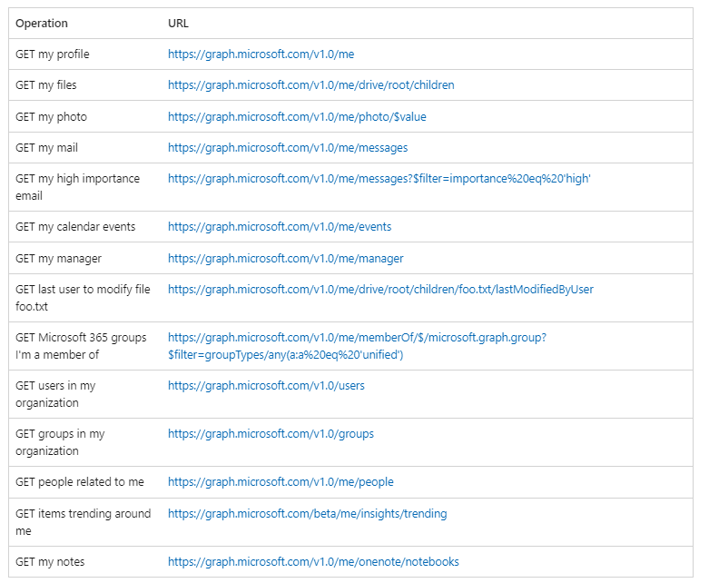

Slide 63
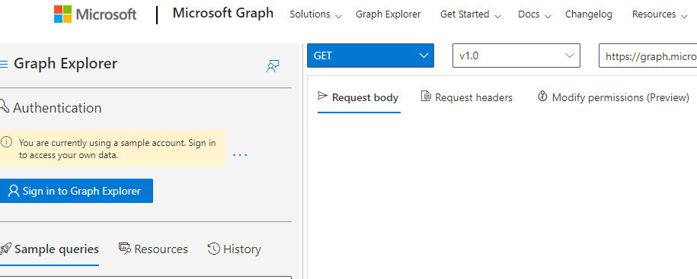
Graph explorer
https://developer.microsoft.com/en-us/graph/graph-explorer

Slide 64
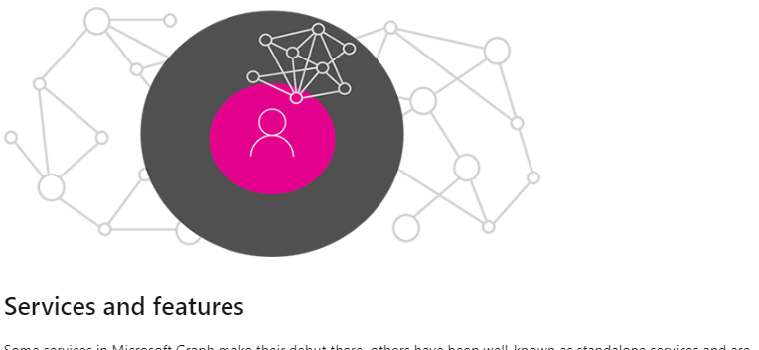
Major services in graph
https://docs.microsoft.com/en-gb/graph/overview-major-services

Slide 65
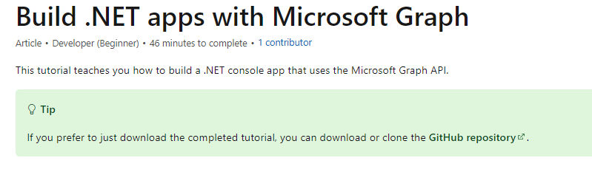
Tutorial: Build .NET apps with Microsoft Graph
https://docs.microsoft.com/en-gb/graph/tutorials/dotnet?tabs=aad

Slide 66
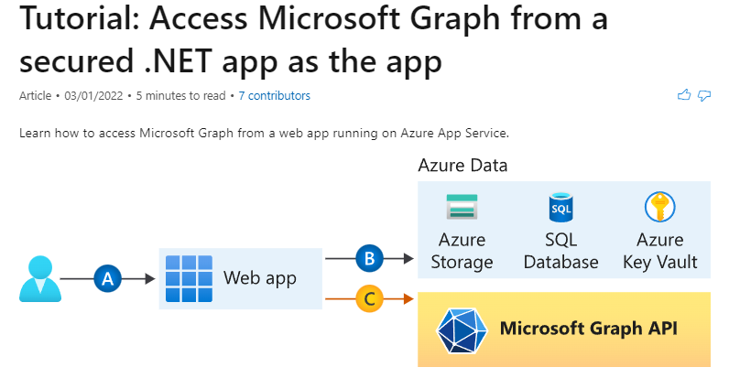
Tutorial: Access Microsoft Graph from a secured .NET app as the app
https://docs.microsoft.com/en-us/azure/app-service/scenario-secure-app-access-microsoft-graph-as-app?tabs=azure-powershell

Slide 67
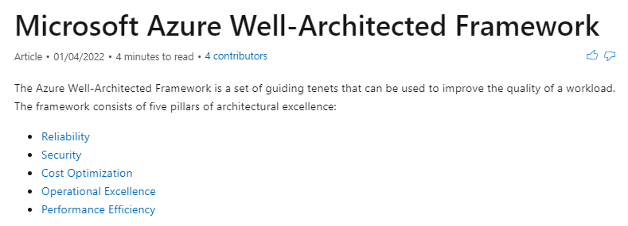
Best practices: well-architected framework
https://docs.microsoft.com/en-us/azure/architecture/framework/

Slide 68
Azure key vault
Notes:
https://azure.microsoft.com/en-gb/services/key-vault/#product-overview

Slide 69
Azure service bus
Notes:
https://docs.microsoft.com/en-us/azure/service-bus-messaging/service-bus-messaging-overview

